Slide 1
INTRODUCTION BACKGROUND
50 Million People
Have epilepsy around the world
9.9 per 1000 People
Prevalence of epilepsy in Pakistan
1/10 Portion
Ratio of world burden of epileptic patients in Pakistan

Slide 2
IOT-VISION ENABLED ASSISTANCE FOR EPILEPTIC PATIENTS

Slide 3


TEAM PRESENTATION
Muhammad Ali Murtaza 2020-CS-114
Ali Tariq 2020-CS-142
Khadija Asif 2020-CS-143
Syed Azeem Ali Hashmi 2020-CS-156

Slide 4

AGENDA
01
INTRODUCTION
02
APPLICATION AREAS
03
SIMILAR MARKET PROJECTS
04
UNIQUE FEATURES
05
ARCHITECTURAL DIAGRAM
06
FEASIBILITY
07
DATA ACQUISITION

Slide 5
INTRODUCTION
IoT-Vision Enabled Assistant for Epileptic Patients
Alert In Emergency Situation
Seizure Detection
Daily Activity Monitoring

Slide 6
Source: CDC Wonder © Statista 2022

Slide 7
INTRODUCTION MOTIVATION
Improved Management of Epilepsy
Reduction in Seizure-Related Injuries
Reducing burden on Nursing Sector
Cost-Effective Solution
Academic Growth

Slide 8






APPLICATION AREAS
01
02
03
HOME HEALTHCARE
HEALTHCARE FACILITIES
NURSING HOME
System can be utilized to offer epileptic patients with constant monitoring and support in their homes.
Hospitals can utilize the technology to monitor patients and offer immediate aid in case of a seizure.
In nursing homes it is used to give continuous supervision and support to epileptic patients.
04
05
06
REMOTE MONITORING
RESEARCH AND DEV
WORKPLACE SAFETY
Medical professionals may remotely monitor epilepsy patients minimizing the need for hospital visits.
It can be used to study epilepsy in detail generating information for medical studies.
It can offer quick assistance to individuals hence lower the risk of workplace accidents and injuries.

Slide 9
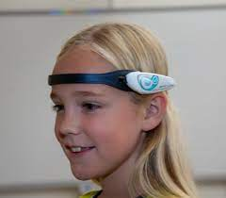
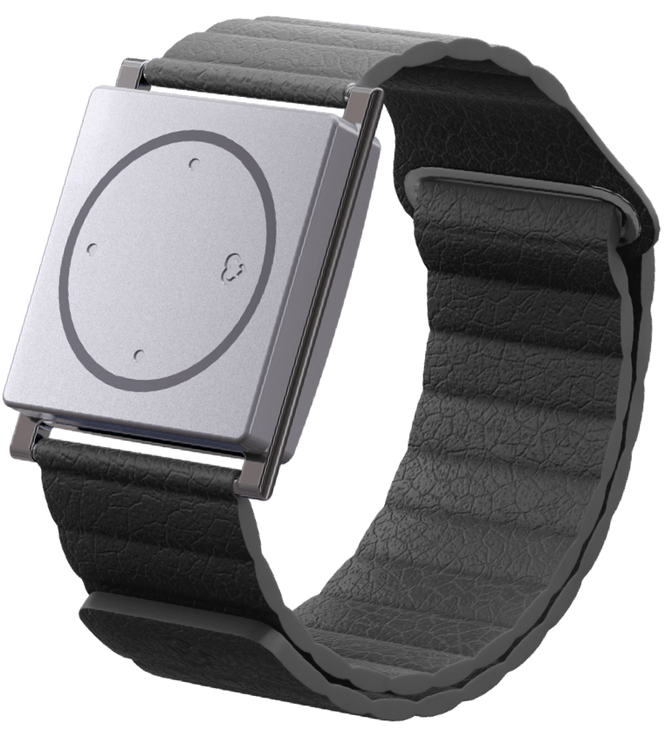
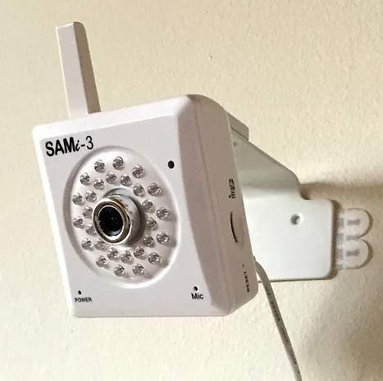
SIMILAR MARKET PROJECTS
Epihunter
Cost: $825.91 – $1,515.91
Detector Location: Scalp
Technique: EEG Signal
Embrace 2
Cost: $249
Subscription: $9.90-$44.90
Detector Location: Wrist
Technique: Sensors
SAMi
Cost: Rs 1,14,00.00
Detector Location: Wall
Technique: Vision

Slide 10
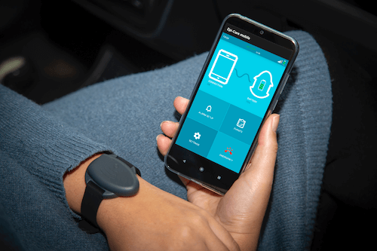
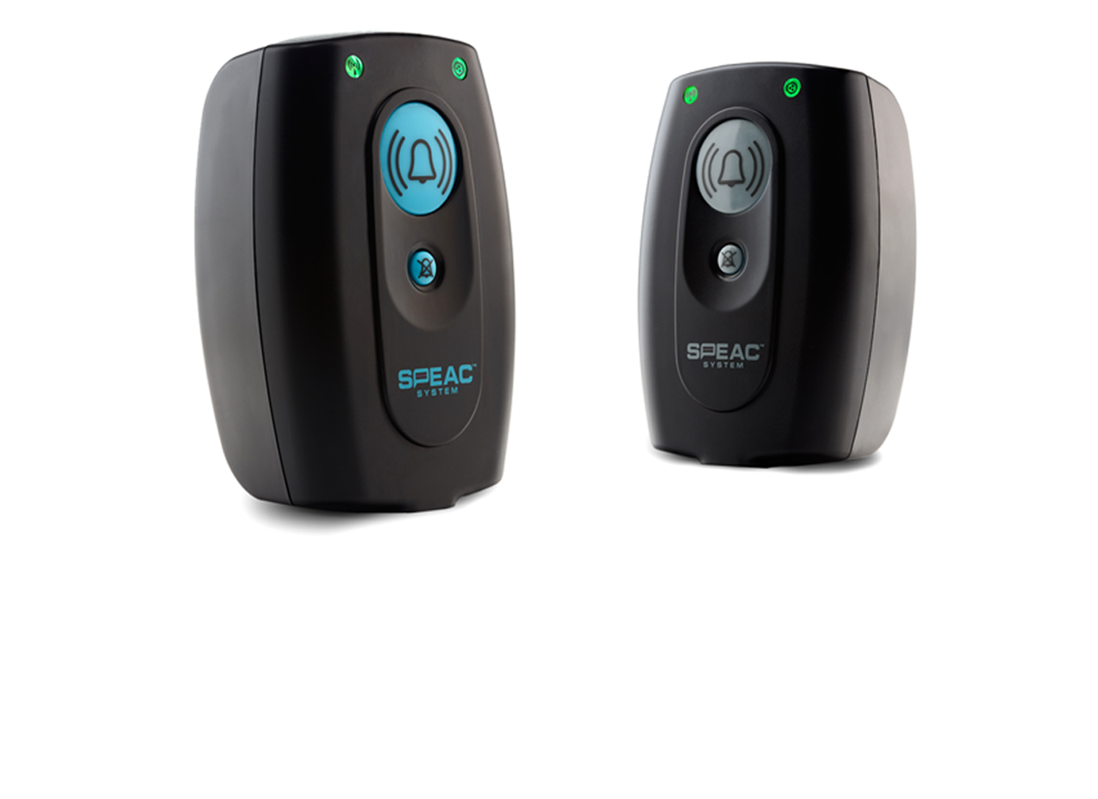
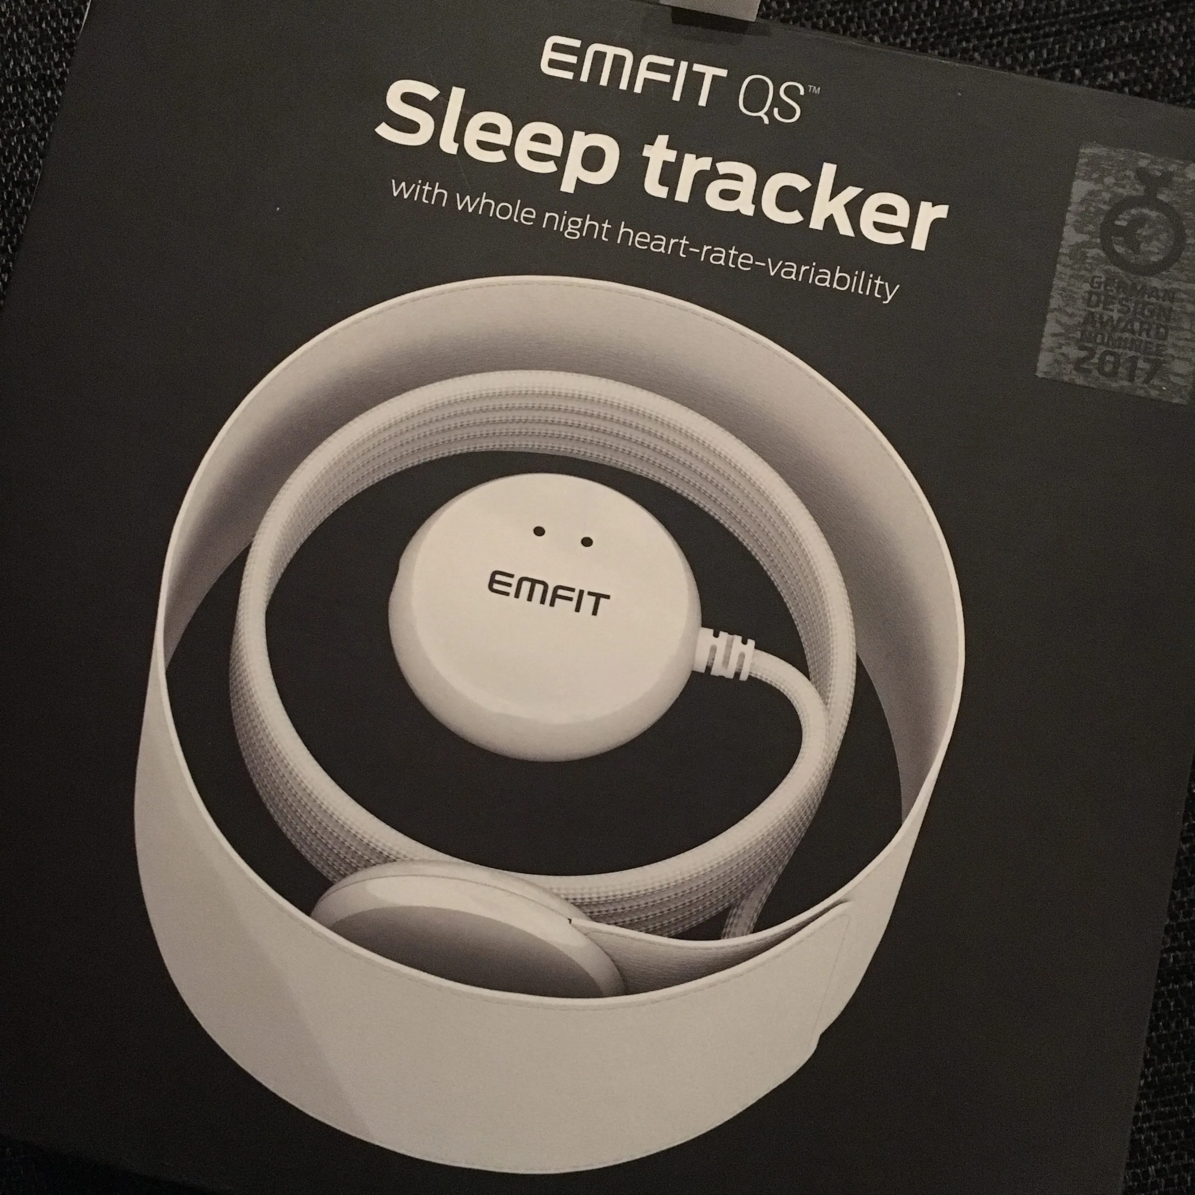
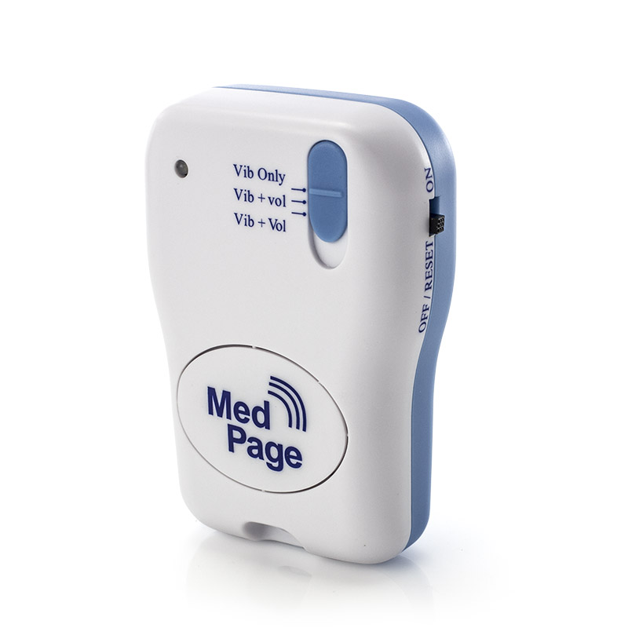
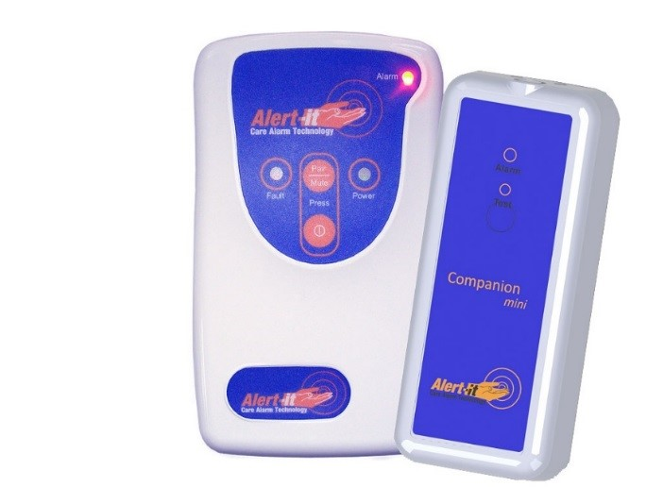
OTHER DEVICES
Epi-care Mobile
Emfit
Epi-care Mobile
MedPage
Alert It Companion by AlertIt

Slide 11





UNIQUE APPLICATION FEATURE
Integration of Camera and Sensors
Sensors capture physiological signals while cameras capture visible changes.
Personalized Machine Learning Approach
Our focus is on personalized model techniques rather than a one-fit-all approach.
More Accurate and Precise
Integration of two techniques will help in generating more accurate results than one-size-fits-all approach.

Slide 12









ARCHITECTURE DIAGRAM
Client Interface (Mobile/Web)
Alert
Client Side Processing
Cloud Server
Monitoring Cameras
Database
Caretaker
Personalized Machine Learning Model
12
Patient

Slide 13



FEASIBILITY STUDY
01
02
03
TECHNICAL FEASIBILITY
ECONOMIC FEASIBILITY
OPERATIONAL FEASIBILITY
Appropriate technology
Seizure detection
Cameras
Sensors
Computer Vision
Web/Mobile Application Interface
Image & Video Processing
Highly skilled Developers
Cost Analysis
Initial cost of development
Cost of Cameras & Sensors
Heavy weight ML models
Cloud services
Database storage
Deployment
Maintenance
Cost of production, research,
Maintenance of the system
Privacy and security
Depth & thermal cameras
Compatibility of the device with the daily environment of the patients
Proper Lightning conditions
Real time data transmission
Ease of use by the caregivers and epileptic patients.
Capability of the system to protect sensitive health data and ensure privacy.

Slide 14
DATA ACQUISITION
Objective is to collect video of epileptic patients during seizure
Ethical approval must be conducted to protect the privacy of patients as well as MOU will be signed with organization i.e. General Hospital
Data collected through video will be validate according to our requirement
1
3
5
2
4
6
Target person is a patient who is suffering from epilepsy. Patient could be of any age, gender and level of severity
The data will be stored on server. Only authorize user has access to server to keep the data secure
Video will be collected using camera. It will take before and after scenario of seizure on patient, timestamp and any trigger action

Slide 15
THANKS!

